Slide 1


Employee Attrition Analytics
Saloni Bhatia
DDSAnalytics

Slide 2
Agenda
Analytics Objectives
Exploratory Data Analysis
Attrition Classification Model
Monthly Income Prediction Model
Conclusion

Slide 3
Business Objective
Identify
Top Predictors of Employee Attrition
Build
Build a classification model - At least 60% specificity and 60% sensitivity
Predict
Monthly Income using RMSE Regression

Slide 4
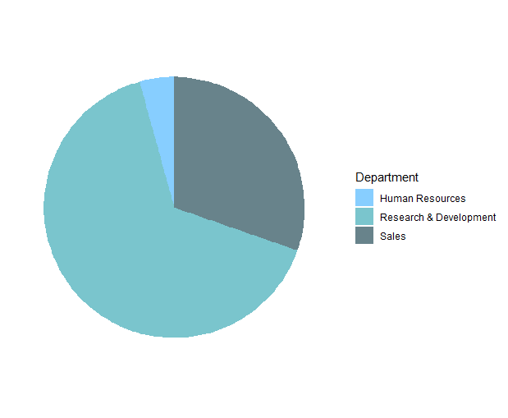
Overall Workforce Summary
Total number of employees: 870
Attrition Count - 140
Number of departments: 3
Human Resources (HR) - 4.02%
Research & Development (R&D) – 64.6%
Sales – 31.38%
Number of work roles: 9
Sales Executives – 23%
Research Scientist – 19.7%
Laboratory Technician – 17.6%
Median age: 36 years
Mean years at company: 7
Median monthly income: $4,900
Number of companies: 58% of employees worked at 2 or <2 companies in the past

Slide 5

Features significance
Overall Attrition rate is 16%
R&D – 53.6%
Sales – 42.14%
HR – 4.29%
Chi-squared test for significance (alpha = 0.05)
No significant impact of variables like Gender, Education, Daily/Hourly/Monthly Rate, Monthly Income, Performance rating, Relationship satisfaction and Time allocation for Training

Slide 6
Identified Key Contributors to Attrition Rates – Two High Level Categories
Quality of Life Factors
Overtime
Environment Satisfaction
Frequent Business Travel
Job Involvement
Distance From Home
Relationship Satisfaction
Career Progression Factors
Number of companies worked for previously
Years since last promotion
Years in current role
Age
Job Role (for specific roles)

Slide 7
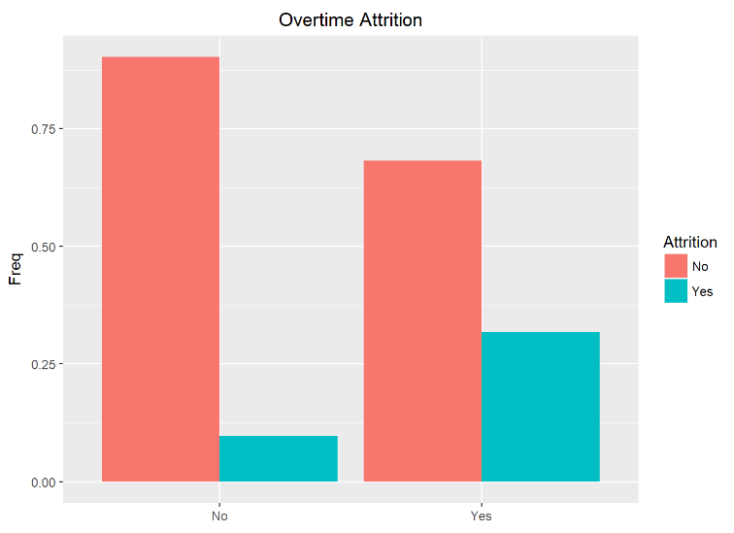
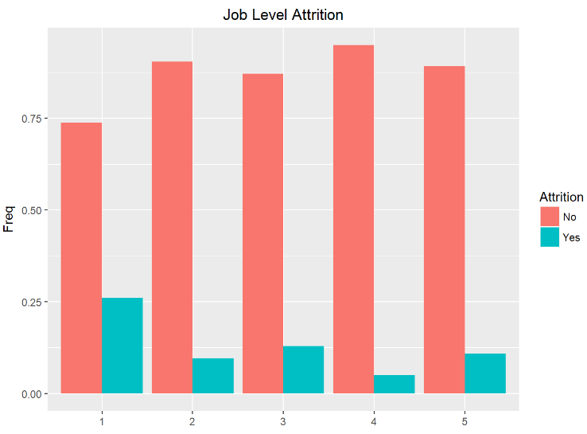
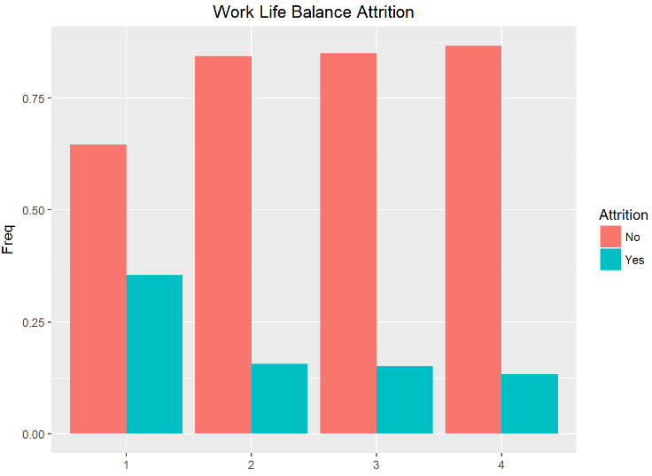
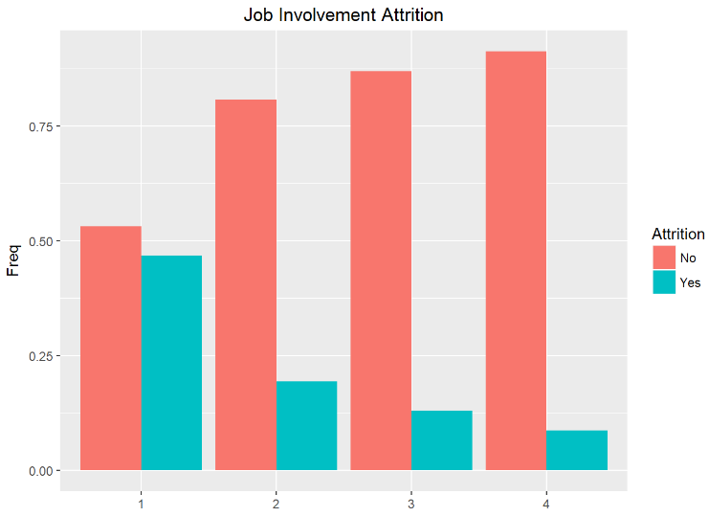
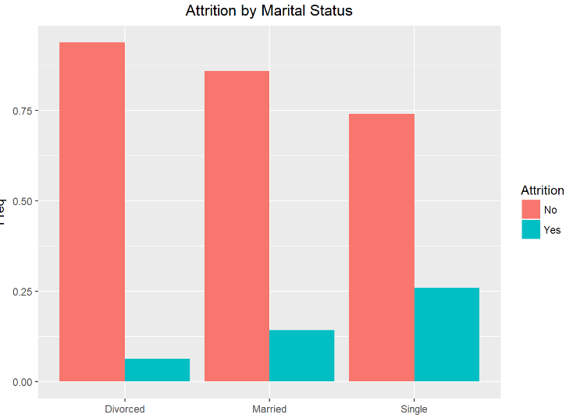
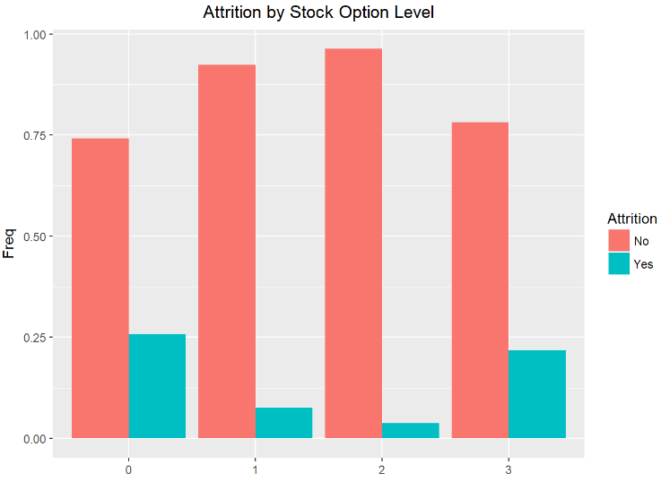
Attrition Insights

Slide 8
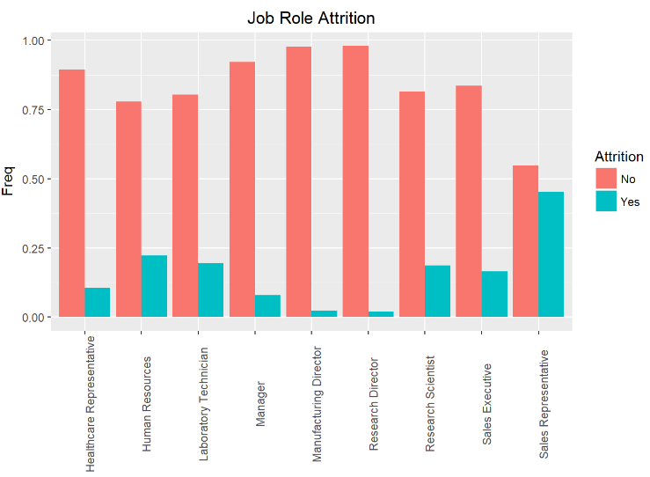
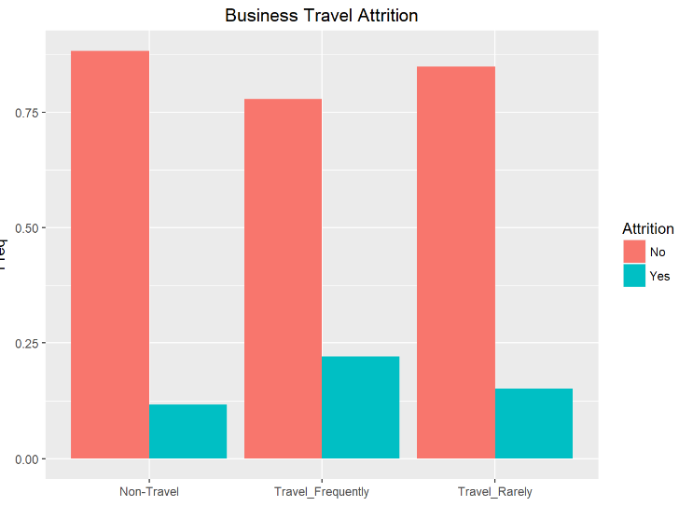
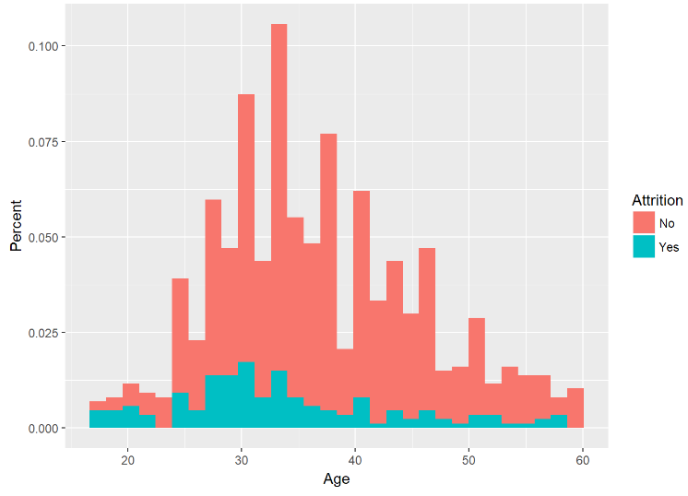
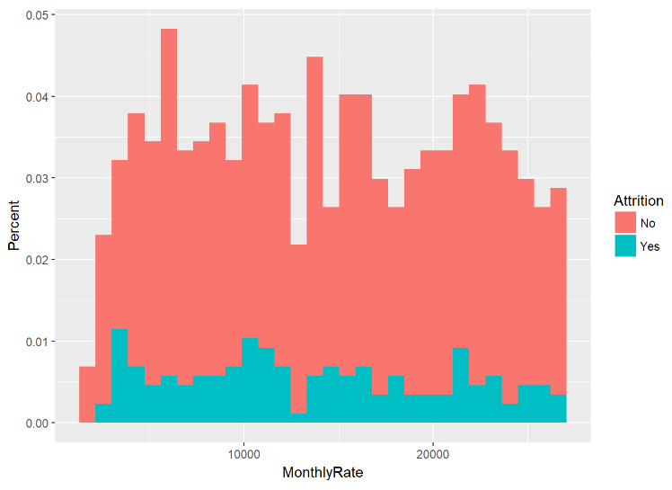
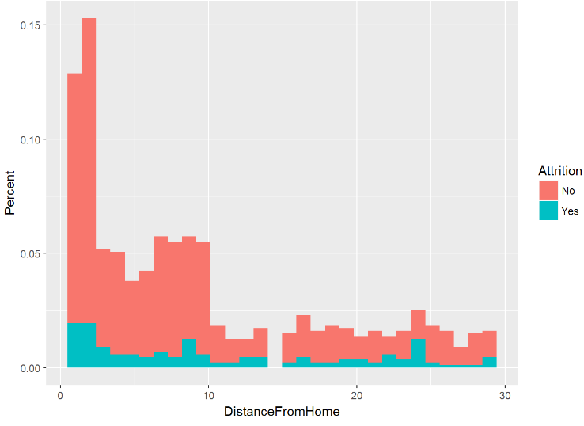
Attrition Insights
Notes:
- The attrition rate appears to increase the more an employee feels they have to travel
- The Sales department has the highest attrition rate (21.6%) followed by HR (17.1%) and R&D (13.3%). However 64.6% of all employee data is from R&D department, followed by Sales with 31.4%
- Within these departments, Managers and Directors have the lowest attrition rates.
- This is inline with the overtime attrition rates as employees who work overtime (non-expempt) have a higher attrition rate of 31.2% compared to 9.7% for those who are salaried (typicaly upper level management).
- Attrition is also highest for employees in lower job levels.
- Oddly, attrition rates are highest with employees who either have the highest (21.8%) or lowest (25.9%) stock options available (levels 0 and 3), with the middle levels both having attrition rates less than 10%.
- Interestingly Divorces employees have the lowest attrition rate at 6.2%, whereas 26% of employees who are single do not choose to stay with the company.
- An employee's environment only appears to increase attrition when rated as most unsatisfactory. This trend also applys to employees who feel like they have a poor work life balance.
- Attrition also appears to increase as Job Involvement Increases (assuming scores range from 1 as little to no involvement to 4 as High Involvement) and decrease as Job Satisfaction increases.

Slide 9

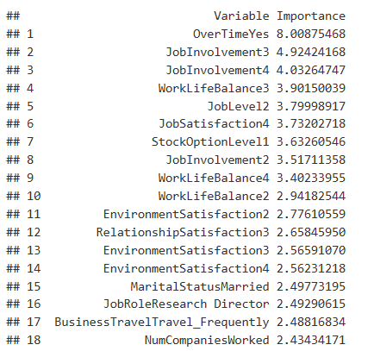
Top 8 Contributors to Attrition Risk
1) Overtime (*p = 1.024e-15*)
2) Job Involvement (*p = 5.211e-09*)
3) Job Level (*p = 2.085e-08*)
4) Job satisfaction(*p =0.01115)
5) Stock Option Level (*p = 3.724e-12*)
6) Marital Status (*p = 3.379e-08*)
7) Job Role(*p = 3.647e-10 )
8) Number Companies worked(*p =0.01678)

Slide 10
Building a model to help mitigate attrition
Naive Bayes Model
KNN Model

Slide 11
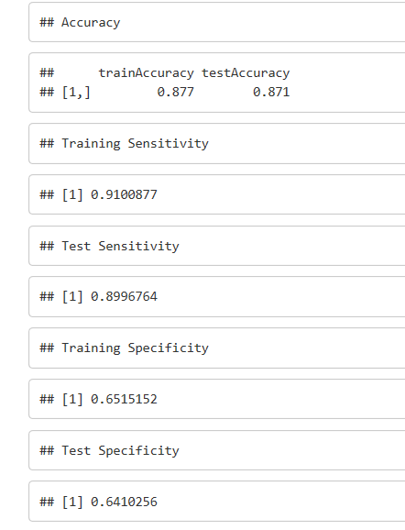
Classification Model
Model 1 – All Variables
Issue - Overfitting with 93% sensitivity and 94% specificity
Model 2 – Excluded few insignificant and highly correlated variables(Daily/Monthly rate)
Model 3 – Included only significant variables (Overtime, Job level, Job Involvement, Job role)
Model 4 – Included all significant variables and removed few highly corelated variables (Years in company)
Model 5 – Predicted using KNN classification

Slide 12
Predict Monthly Income
Linear Regression

Slide 13
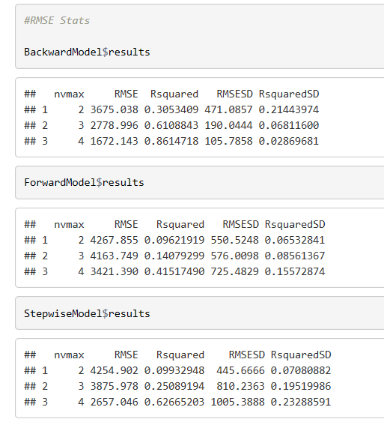
Prediction Model
Model 1 – Forward Selection
RMSE : 3421.3
Model 2 – Backward Selection
RMSE : 1672.1
Model 3 – Stepwise Selection
RMSE : 2657

Slide 14
Closing Thoughts
Attrition factors
Attrition Classification
Income Prediction

Slide 15
Q&A or Feedback
Saloni Bhatia
Email – salonib@smu.edu
https://www.youtube.com/watch?v=5bmrSDLw1Nk

